Slide 1
VISUAL C#.NET session 23
Instructor: Edwin oduor

Slide 2

Quote of the day

Slide 3
Lesson objectives
Performing CRUD Operations

Slide 4
Lesson pre-requisites
In order to take full advantage of this section you need to have the following;
Computer with Visual Studio Installed.
Stable Network Connection.

Slide 5
Training methods and extra readings
TRAINING METHODS FOR THIS LESSON
EXTRA READINGS
Lecturing Method – This is the main method of training to be adopted in this lesson with illustrations and practical coding examples.
Discussion Method - This method will be adopted periodically whereby learning will be derived principally from the students brainstorming together, rather than from the trainer. Three main types of discussions will be used:
Directed discussion
Developmental discussion
Problem-Solving discussion
Home and Learn C#

Slide 6
Desktop application deployment

Slide 7
To Deploy a desktop application is to take the application that was designed in the developer’s computer and have it run in the client’s or user’s computer so that they can use this application to perform their tasks.
To do this there are a few things that we need to consider, one if the application will be using the database, then the database has to be backed up and the backed-up file used in the client’s machine, when this happens then the client’s machine will be able to have the database and all the tables that will be needed for the application.

Slide 8
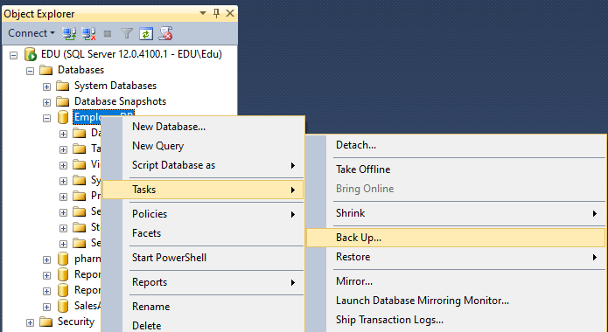
Backing up a database
Open SQL Server, right click on the database to be backed up, choose tasks, then click on Back Up. The following window will be displayed. Click Ok for the database to be backed up. It’s going to be backed up note the location where the backed up fille is going to be stored.

Slide 9
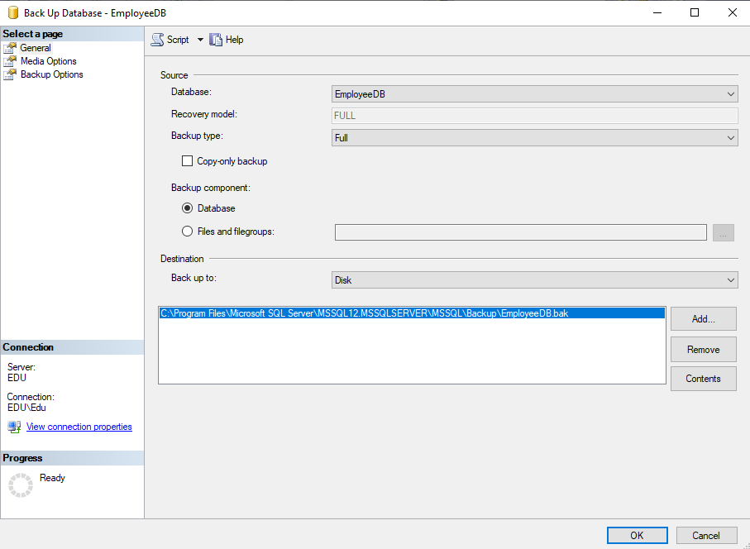
Once the database has been backed up then next thing is to take the backed-up database and restore it in the client’s machine so as to use the database.

Slide 10
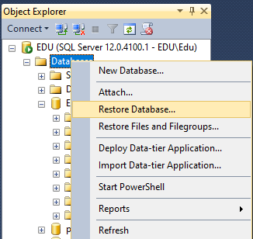
Restoring the database.
Right click on the database folder and choose restore database.

Slide 11
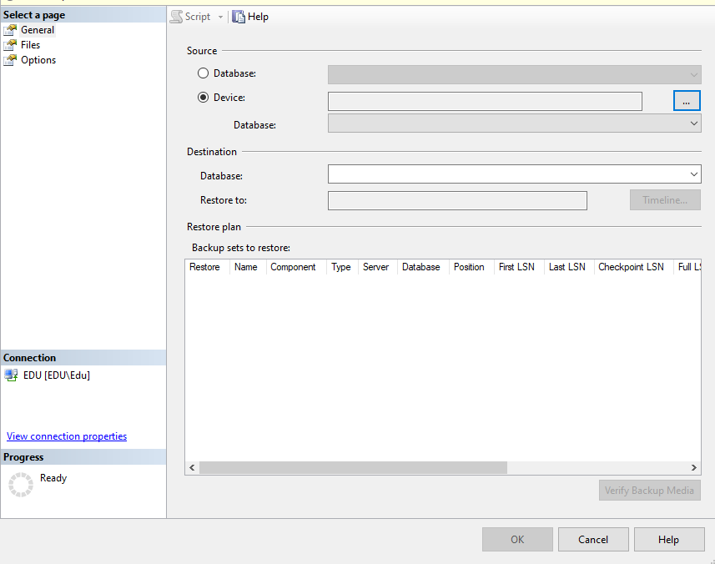
The moment the restore has been clicked on this is what is going to be displayed. Choose device and click on the button with 3 dots, to browse for the location of the file.

Slide 12
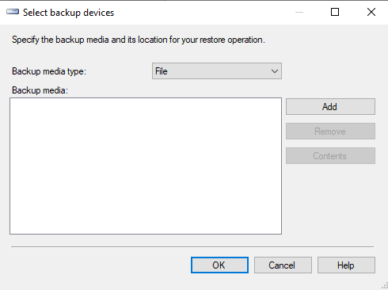
When the 3 dots are clicked on, this is the dialogue box that will display.

Slide 13
Click Add button to browse for the file, once you have browsed for the file click ok, ok and ok again to finish up on restoring the database.
Lastly to take the folder that has the application and run the executable file, to make it executable then one needs to click on build, build solution. This is done from visual studio. At the bottom left of your screen one will be able to see if the build was a success.
After this go to the location where your project is saved, open the folder that has the project name, bin, debug inside debug one will get the file, the type of the file is an application file. That is the file that when clicked on it will open that application, hence that is the file that should be taken to be used as an executable file.

